Slide 1
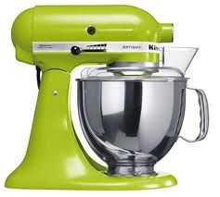
mixins and mixes in JavaScript

Slide 2



Anders Jönsson ( ) #anjonsson andersjonsson.blogspot.com github.com/archive

Slide 3
agenda
overview
area of usages
why mixins?
where to mix?
drawbacks
unit testing
different type of mixers
mixin vs dependency injection
please, feel free to interrupt me at any time

Slide 4

this is about mixin in JavaScript - not mixin in Ruby/Lisp/etc (javascript do not support mixins on the language level, but it can easily be mimic with code)

Slide 5
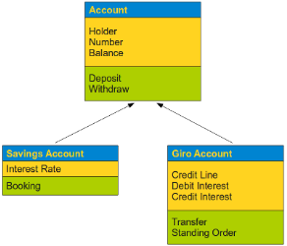

why mixins?
it's not classical inheritance!
pattern to reuse code/
functioniallity
change inner/outer behaviors from the outside*
* yeah, and this can get really bad!

Slide 6
object A
object B
object C

Slide 7
object A
object B
object C

Slide 8
object A
object B
object C
mixin

Slide 9
object A
object B
object C
copy
copy
copy
mixer (augmenter)
mixin

Slide 10
Demo! (BookService)

Slide 11


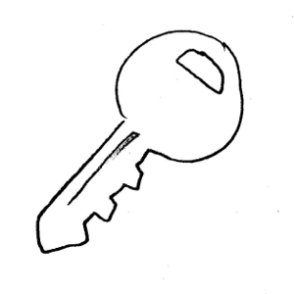

area of usages
roles
reuse of elements
caching
security
other...
transformation
adding behavior or changing existing behavior

Slide 12
Demo! (JSONify)

Slide 13

mixin _private methods? - yeah why not!

Slide 14
Demo! (ProductView)

Slide 15


where to mix?
in function constructor
on the function prototype
on the object
it depends on you needs

Slide 16


"strict" and "loose" mixer
fails silently
fails loudly
contract

Slide 17
mixin vs dependency injection
independent concept
dependent/
sub concept

Slide 18
unit testing? test the mixins in isolation?

Slide 19

drawbacks
?
?
?
?
?
unclear capabilities / behaviors
hard to read the code
unplanned dependencies
Notes:
http://gmarik.info/notes/programming/modularity

Slide 20
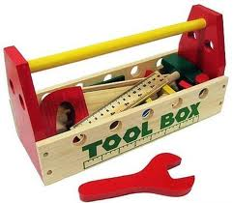
but it's a powerful tool and it should be in your toolbox

Slide 21
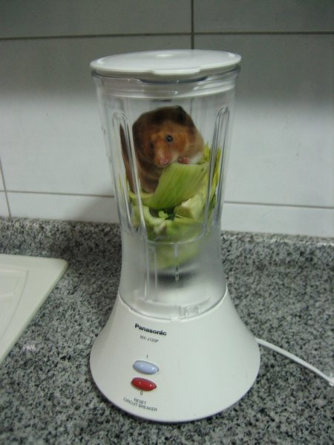
... and remember to mix carefully

Slide 22
thanks! questions? #anjonsson andersjonsson.blogspot.com github.com/archive
images from:
twitter - http://www.erikzona.com/tag/twitter/
rss - http://www.iiasa.ac.at/RSS/
hamster - http://www.travelblog.org/Photos/3268923
speaker - http://analogstudios.net/images/psds/assets/icons/
toolbox - https://mnslis.wordpress.com/2011/05/10/dr-mueller%E2%80%99s-authentic-assessment-toolbox/
handshake - http://amspirit.blogspot.com/2010/11/handshake-etiquette.html
document - http://www.clker.com/clipart-2297.html, http://www.abadev.com/doc_conv/
police Siren - http://www.amazon.com/Rotating-Warning-Police-Siren-Light/dp/B002R2INO4
constructor - http://www.skyddsprodukter.se/huvudskydd/skyddshjalmar/standardhjalmar/?sp=21&vm=
roles - http://www.uen.org/cte/family/life_management/unit_3.shtml
images from:
key - http://www.stlouislocksmith.com/
warning - http://www.korguksupport.co.uk/page-li.cfm?pageID=615&next=117&pageMenu=186
pattern - http://thundafunda.com/2/animals-body-texture/cheetah-skin-pattern-backgrounds-pictures-animals.php
mixer - http://casablancacuisine.com/can-a-kitchenaid-mixer-make-meringue/
inheritance - http://www.python-course.eu/object_oriented_programming.php
private - http://mariaroth.blogspot.com/2010/02/operation-overlord.html
ui elements - http://www.flashmint.com/free/buttons.php
transformers - http://weloveicons.com/2009/06/transformers-2/
github - http://warpspire.com/posts/joining-github/

